Slide 1
5-1 USING IT TO TALK ABOUT TIME
What day is it?
Sunday
Monday
Tuesday
Wednesday
Thursday
Friday
Saturday

Slide 2
5-1 USING IT TO TALK ABOUT TIME
QUESTION
ANSWER
(a) What day is it?
(b) What month is it?
(c) What year is it?
It’s Wednesday.
It’s May.
It’s 2011.

Slide 3
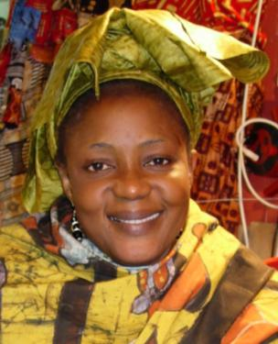

5-1 Let’s Practice
What day is it?
______________.
It’s
Sunday
Sunday
Monday
Tuesday
Wednesday
Thursday
Friday
Saturday

Slide 4
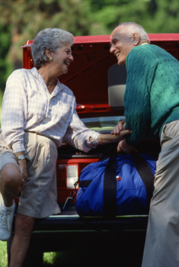
5-1 Let’s Practice
It’s Tuesday.
What day
is it
_______________?
Sunday
Monday
Tuesday
Wednesday
Thursday
Friday
Saturday

Slide 5
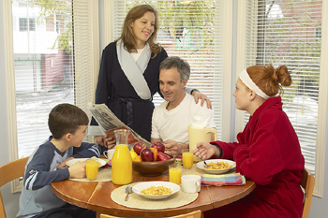
5-2 PREPOSITIONS OF TIME
They eat breakfast
in the morning.

Slide 6
5-2 PREPOSITIONS OF TIME
at
(a) They get up at 5:00 A.M.
(b) My brothers exercise at 2:00 P.M.
at + specific time

Slide 7
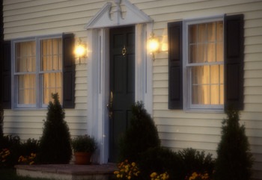
5-2 PREPOSITIONS OF TIME
at
(c) I arrive home at night.
at + night

Slide 8
5-2 PREPOSITIONS OF TIME
in
(d) I have breakfast in the morning.
(e) I take a walk in the afternoon.
(f) He reads a book in the afternoon.
in + the morning
in + the afternoon

Slide 9
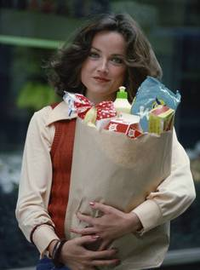
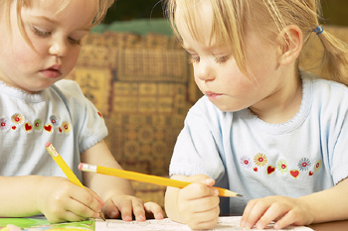
5-2 PREPOSITIONS OF TIME
on
(i) She goes shopping on Tuesday.
(j) The girls visit their grandmother on Sunday afternoon.
on + specific day

Slide 10
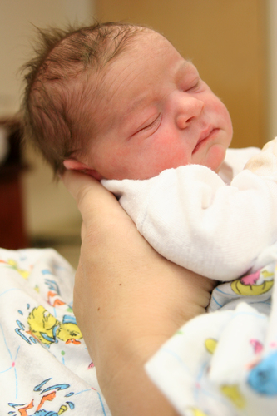
5-2 Let’s Practice
at in on from ... to
on
The baby was born __ Monday.
The baby was born __ the afternoon.
in
at
The baby was born __ 2:00 P.M.

Slide 11
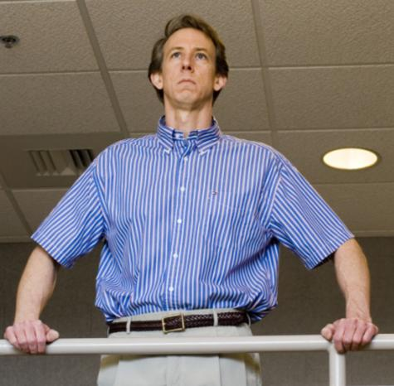
5-2 Let’s Practice
at in on from ... to
in
I work ____ the morning.

Slide 12
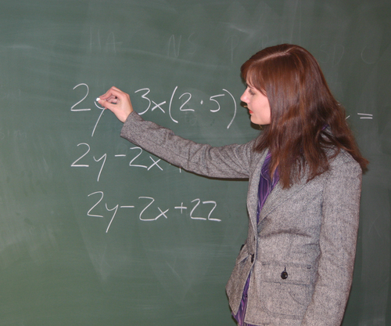
5-2 Let’s Practice
at in on from ... to
I teach a class __ 7:00 __ Monday.
at
on

Slide 13
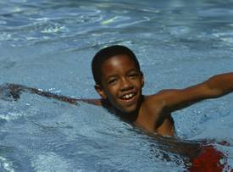
5-2 Let’s Practice
at in on from ... to
He swims __ the afternoon.
in

Slide 14
